Slide 1

Cyberattack Trends by Sector
Project Title
Technologies: Python | Machine Learning | Power BI
Presented By
Simran Bhadouria
Leader in Consulting
https://gncipl.com/

Slide 2

Project Objective
• Analyze cybersecurity incidents across industries
• Identify high-risk sectors
• Find common attack vectors
• Predict attack types using Machine Learning
• Create an interactive Power BI dashboard

Slide 3
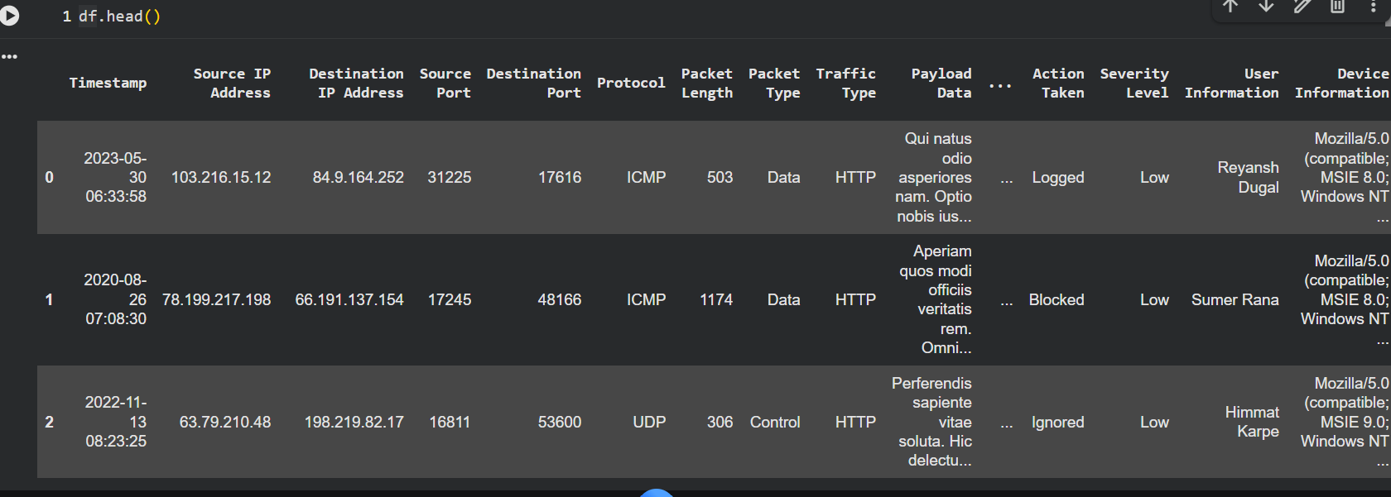
Dataset Information
Dataset Source:
Kaggle Cybersecurity Dataset https://www.kaggle.com/datasets/teamincribo/cyber-security-attacks
Key Features: • Timestamp • Source IP Address • Device Information • Traffic Type • Geo-location Data • Packet Type

Slide 4
Project Workflow
Data Collection ↓ Data Cleaning ↓
Machine Learning Model ↓
Feature Engineering
↓ Exploratory Data Analysis ↓ Power BI Dashboard

Slide 5
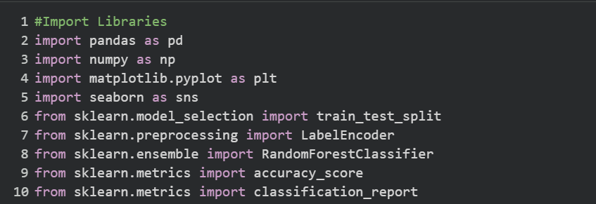
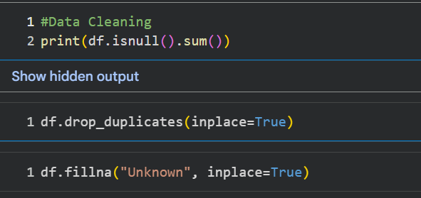
Data Cleaning and Import lib
Import Libraries
Python
Numpy
Matplotlib
Seborn
Skitlearn
Removed duplicate records
Handled missing values
Checked data types
Encoded categorical variables
Prepared dataset for ML

Slide 6
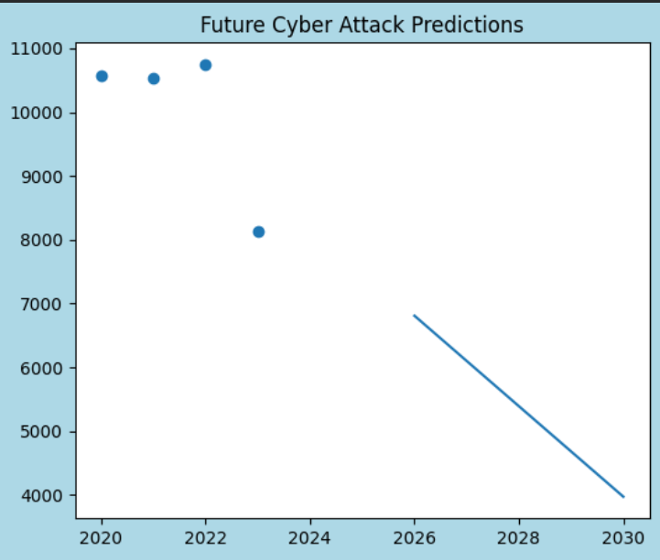
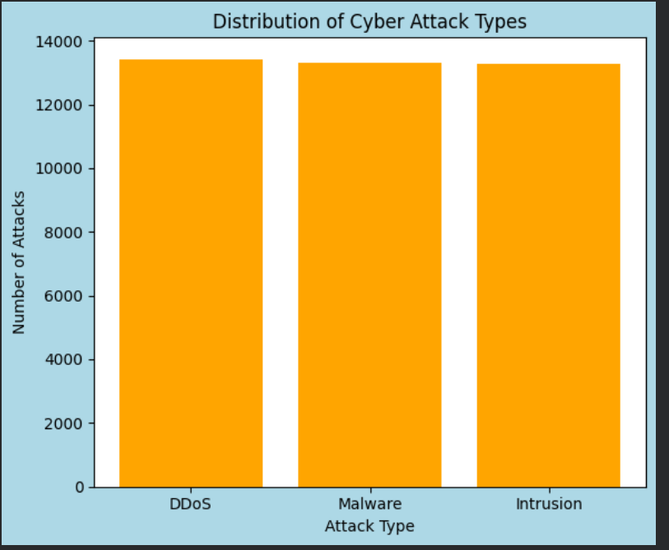
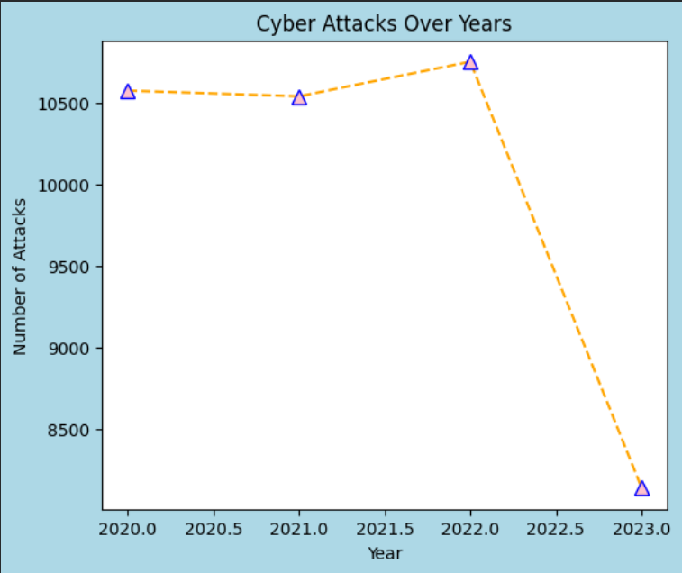
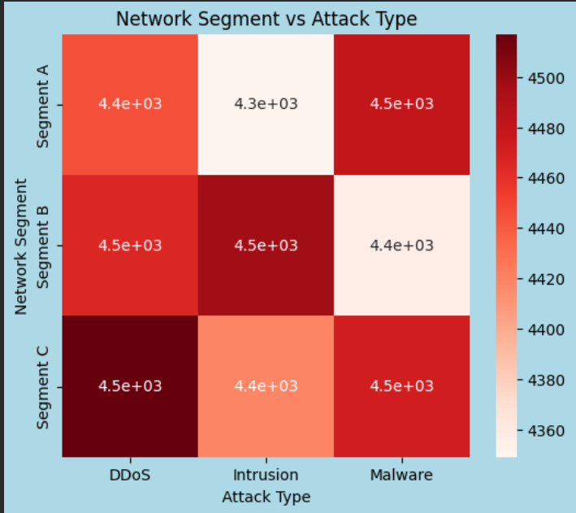
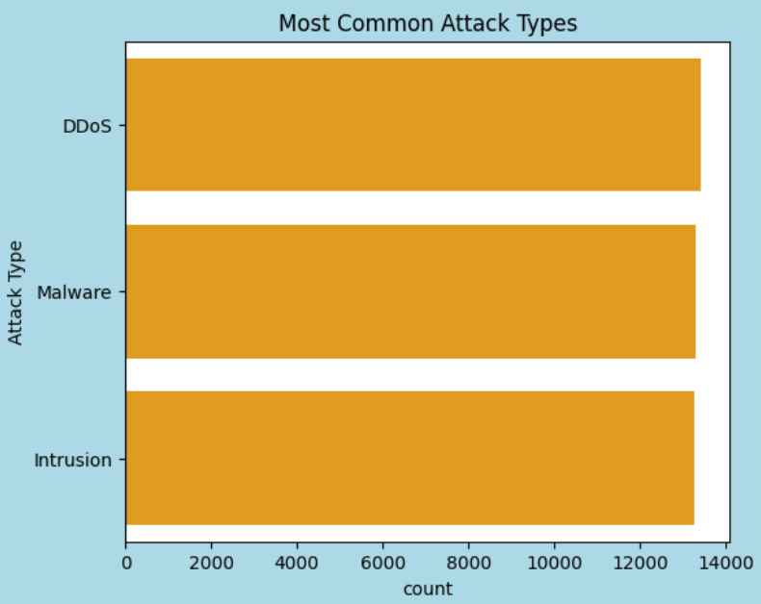
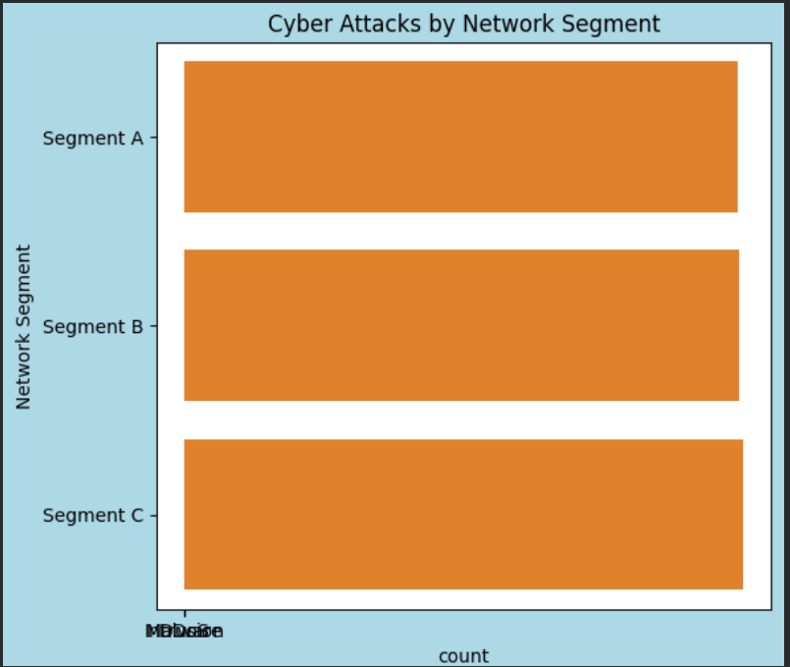
Exploratory Data Analysis
Insights Generated:
Cyber Attacks by Network Segment
Distribution of Cyber Attack Type
Feature Importance
Cyber Attacks Over Years
Most Common Attack Types
Network Segment vs Attack Type
Future Cyber Attack Predictions

Slide 7
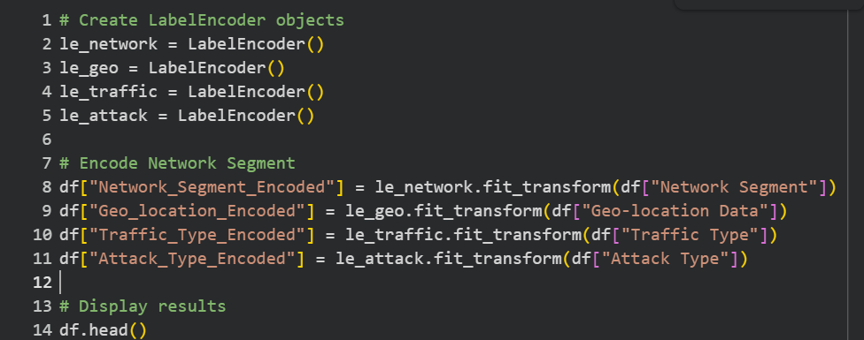
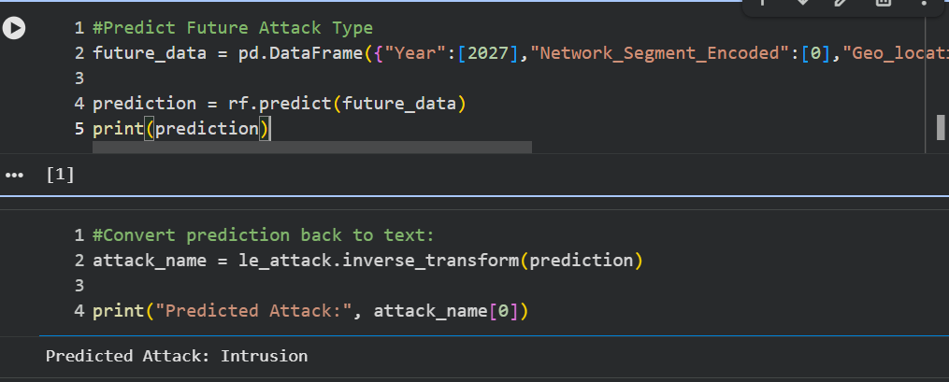
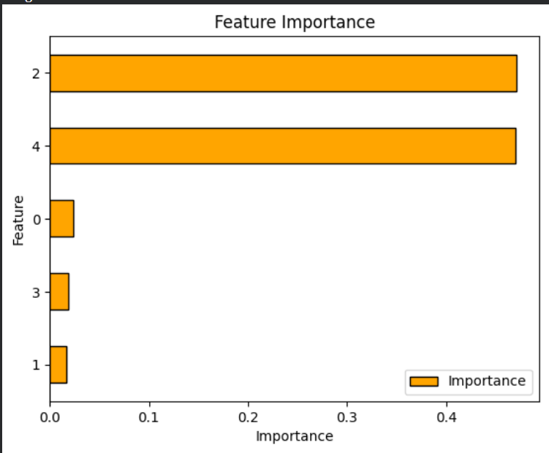
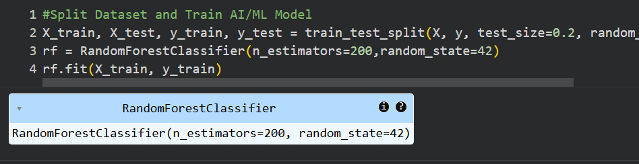
Machine Learning Approach
Algorithm: Random Forest Classifier Features:
• Network Segment • Geo-location Data • Traffic Type • Attack Type

Slide 8
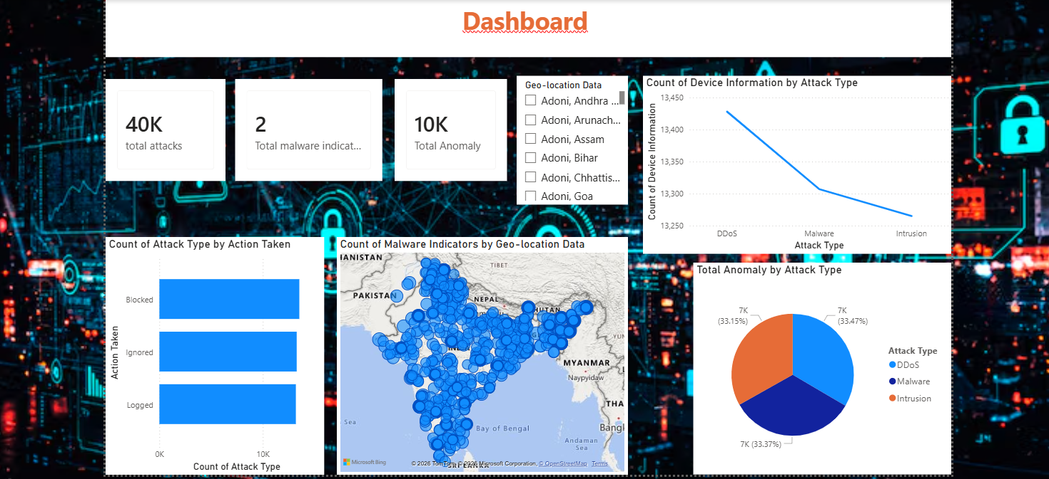
Dashboard Components
Card Visual
• Total Attacks • Total Malware indication • Total anomaly Visualizations
• Count of Device info by Attack Type • Count of Attack Type by Action Taken • Malware Indicators by Geo-Ioc Data • Total Anomaly by Attack Type

Slide 9
Conclusion
Successfully analyzed cybersecurity attack trends across sectors.
Identified the most common cyber threats and vulnerable network segments.
Built a Machine Learning model to predict attack types.
Discovered important factors influencing cyberattacks through feature importance analysis.
Forecasted future attack trends using historical data.
Developed a foundation for real-time cybersecurity monitoring and decision support.
Business Value
Improves threat awareness.
Supports risk management strategies.
Helps organizations prioritize security investments.
Enables proactive cybersecurity planning.

Slide 10
Future Scope
Implement advanced ML models such as XGBoost and LightGBM.
Integrate real-time cyber threat intelligence feeds.
Develop anomaly detection systems for early threat identification.
Deploy the model using Streamlit or Flask.
Create an automated cybersecurity monitoring dashboard.
Improve prediction accuracy with additional security features.

